Slide 1

IST722 Data Warehousing
Business Intelligence Development with SQL Server Analysis Services and Excel 2013
Michael A. Fudge, Jr.

Slide 2
What is SQL Server Analysis Services?
SSAS is a Multi-Dimensional Online Analytical Processing Database (MOLAP).
Databases can be designed top down (ROLAP exists) or bottom up (generate ROLAP schema).
You build out Dimensions and Cubes (Fact tables).
Cubes represent the MOLAP version of the dimensional model.
Supports MOLAP, ROLAP and Hybrid HOLAP models. In ROLAP mode, data is not copied into the Analysis Services Db. (Demo?)

Slide 3
What is a MOLAP Database?
Consolidate multiple data sources into a single model
Clear separation of facts and dimensions
Unknown members
Robust Attribute properties
Define hierarchies
Pre defined aggregates (Attribute relationships)
Calculations / KPI’s
Perspectives

Slide 4
The MOLAP Development Process
SQL Server
SQL Server Analysis Services
BI Tool
ROLAP Dimensional Model
Connect Data Sources and Design Data Source Views
Develop
Dimensions
Develop
Cubes
Deploy To Server
Visualize / Explore

Slide 5
Analysis Services Processing
Before you can view changes you make in the SSAS database, you must first process the data.
SSAS Database
ROLAP Dimensional Model
Fact Table
Process: Load Data, Perform Calculations
Cube
Dimension Tables
Dimensions

Slide 6
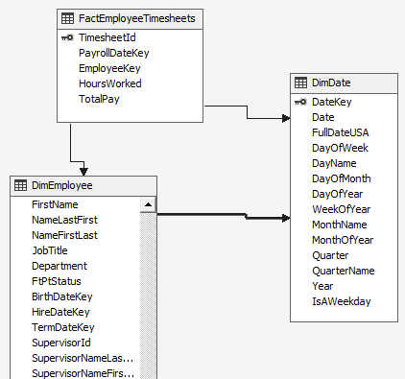
Connecting Data Sources & Views
Connect to a ROLAP Source
Create a Data source view to combine tables from disparate sources
Derive calculated columns for values which do not exist.
Establish relationships which are not in the ROLAP schema.

Slide 7
Developing Dimensions: Steps
Create Dimension from Source
Add and Configure Attributes
Configure Hierarchies
Configure Attribute Relationships

Slide 8
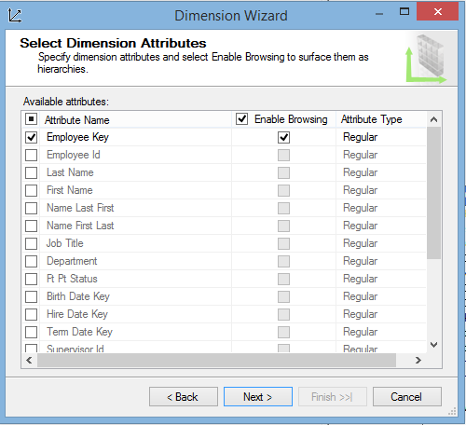

1. Creating Dimensions from Source
Choose the ROLAP Dimension from the Data Source View
Start with only the Key Attribute
Add the other Attributes manually.
Best Practice: Drop “Dim” from the Name.

Slide 9
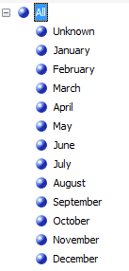
2. Configuring Attributes
We configure how we want the attributes presented to the user.
Key Properties
Name
Key Column
Name Column
Value Column
Order By (Key Or Name)
Example: Month
Key: Month Of Year
Value: Month Name
Order by: Key

Slide 10
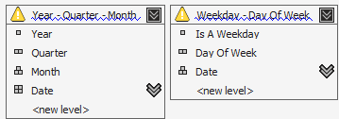
3. Configure Hierarchies
Allow us to Drill-Down through attributes.
Three Types:
Natural - 1-M Relationship among hierarchies
Ex: Year → Month → Day
Unnatural – No dependent relationship
Ex: Color → Size
Parent-Child –
Ex: Employee → Supervisor
Automatic when self-join exists in dimension.
Examples:

Slide 11
Develop Cubes: Steps
Select Fact Table – adds measures and determines dimensions.
Add and Configure each Measure (Fact) Properties
Add Calculations – Business Rules to the Cube
Add KPI’s – Key Performance Indicators
Configure Aggregations – Summary Tables
Configure Perspectives – Cube Views

Slide 12

1. Select Fact Table
To build a cube you must include at least one fact table. This initiates the cube building process.
You can have more than one fact table in the cube.
This allows you to consolidate logic into a single point of access for the user.
Each fact grain will contain the same measure group.

Slide 13
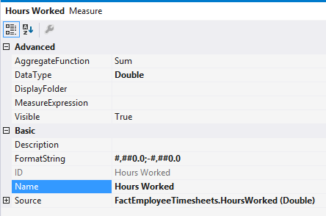
2. Configuring Measure Properties
We configure how we want the measures presented to the user.
Key Properties
Name
Format String
Aggregate Function: Sum, Count, Min/Max, None
Visibility: Show / Hide
Measure Group

Slide 14
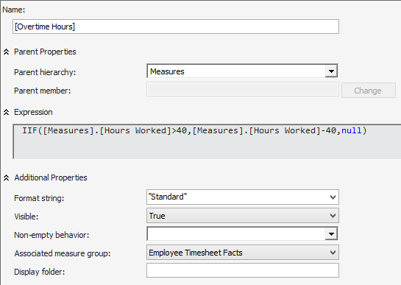
3. Add Calculations
Additional Calculations based on current measures.
Function Builder to help you out.

Slide 15
KPI’s – Key Performance Indicators
You need:
Value – What you’re measuring
Goal – What you want achieve
Status – How close is the value to the goal? Range between -1 and 1
Trend – Status over time periods. Range between -1 and 1
Example:
Value: Overtime Hours
Goal: 0
Status:
when Overtime = 0 then 1
when Overtime >=10 then -1
Else 0
Trend:
When Overtime < Last Time period overtime then 1 etc…

Slide 16
Visualizing / Exploring Your Cubes
Excel 2013
Pivot Tables / Pivot Charts
PowerPivot / Power View
EXPERIMENTAL:
WebPivotTable: http://ist-cs-dw1.ad.syr.edu/
Analysis Server URL:
http://ist-cs-dw1.ad.syr.edu/olap/msmdpump.dll

Slide 17
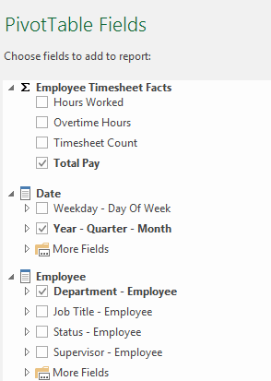
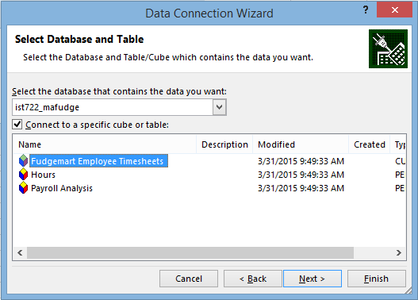
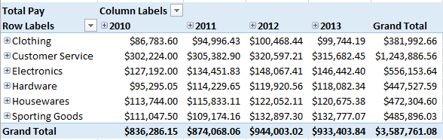
Pivot Tables
Use SSAS as a data source
BI Semantic Model
Understands measures, data types and hierarchies

Slide 18
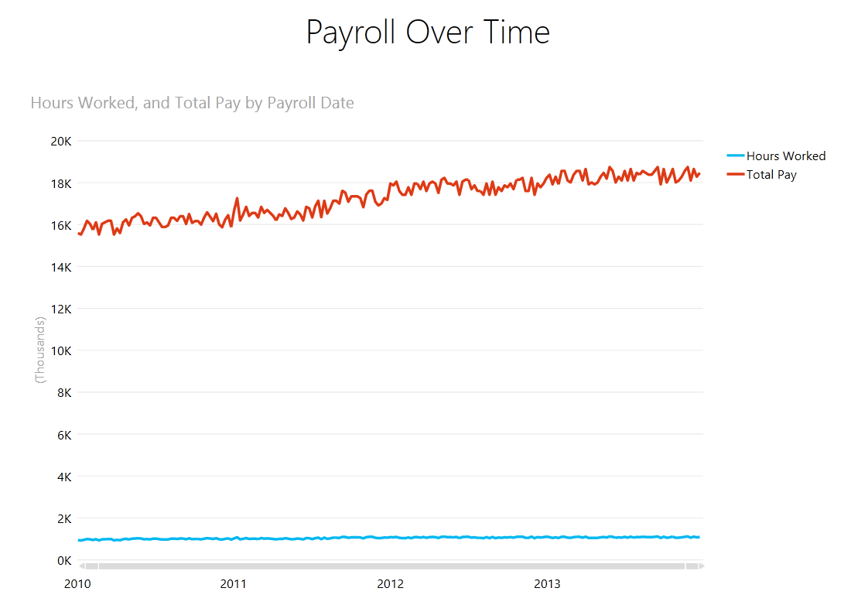
Power View
Interactive, Dashboard style views
☹ Does not support SSAS Cubes… Yet. ☹
PowerPivot to the Rescue…

Slide 19
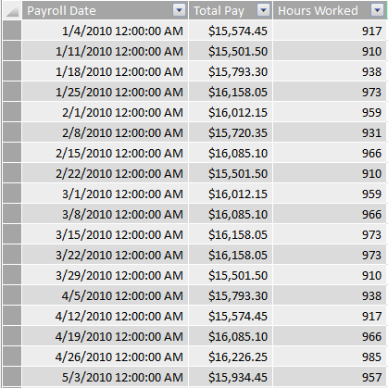
PowerPivot
A Database Inside Excel.
Uses the xVelocity column-store database engine to store data in memory efficiently.
For when your data has more rows than Excel allows.
Data Sources can come from a variety of places, including SSAS…
☹ Builds its own semantic model. Does not read the SSIS semantic model ☹

Slide 20
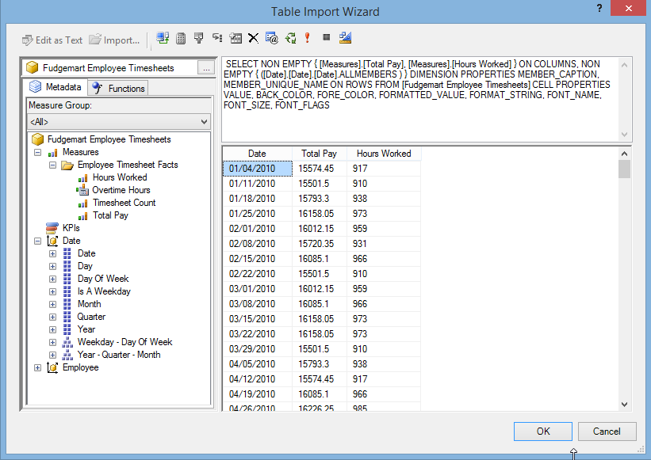
MDX Query
SQL for MOLAP Databases
Allows you to query your cube and retrieve tabular data.

Slide 21
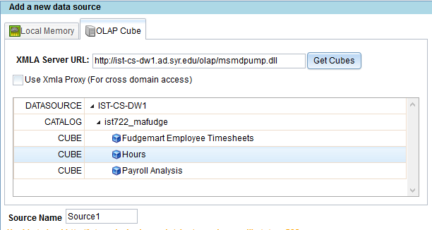
http://webpivottable.com/
“Does what is says”
Open Source
Install on a website
Reads SSAS Cubes… buggy.
Installed here:
http://ist-cs-dw1.ad.syr.edu/
Analysis Server URL:
http://ist-cs-dw1.ad.syr.edu/olap/msmdpump.dll

Slide 22
IST722 Data Warehousing
Business Intelligence Development with SQL Server Analysis Services and Excel 2013
Michael A. Fudge, Jr.

